Slide 1


Slide 2
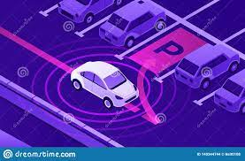
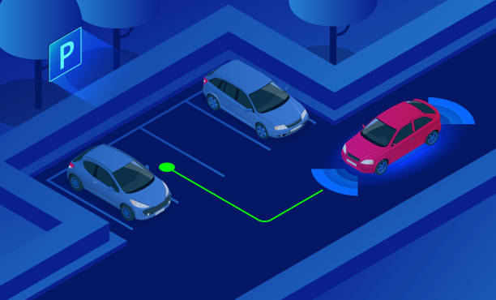
TITLE
Auto-Parking Of Vehicle By Using Supervised Learning Approach

Slide 3

TEAM
SUPERVISOR
Dr. Muwahida Liaquat
GROUP MEMBERS
Mazahir Hussain
Mustaqeem Ashraf
Tooba Anwar
Shamsa Kanwal

Slide 4
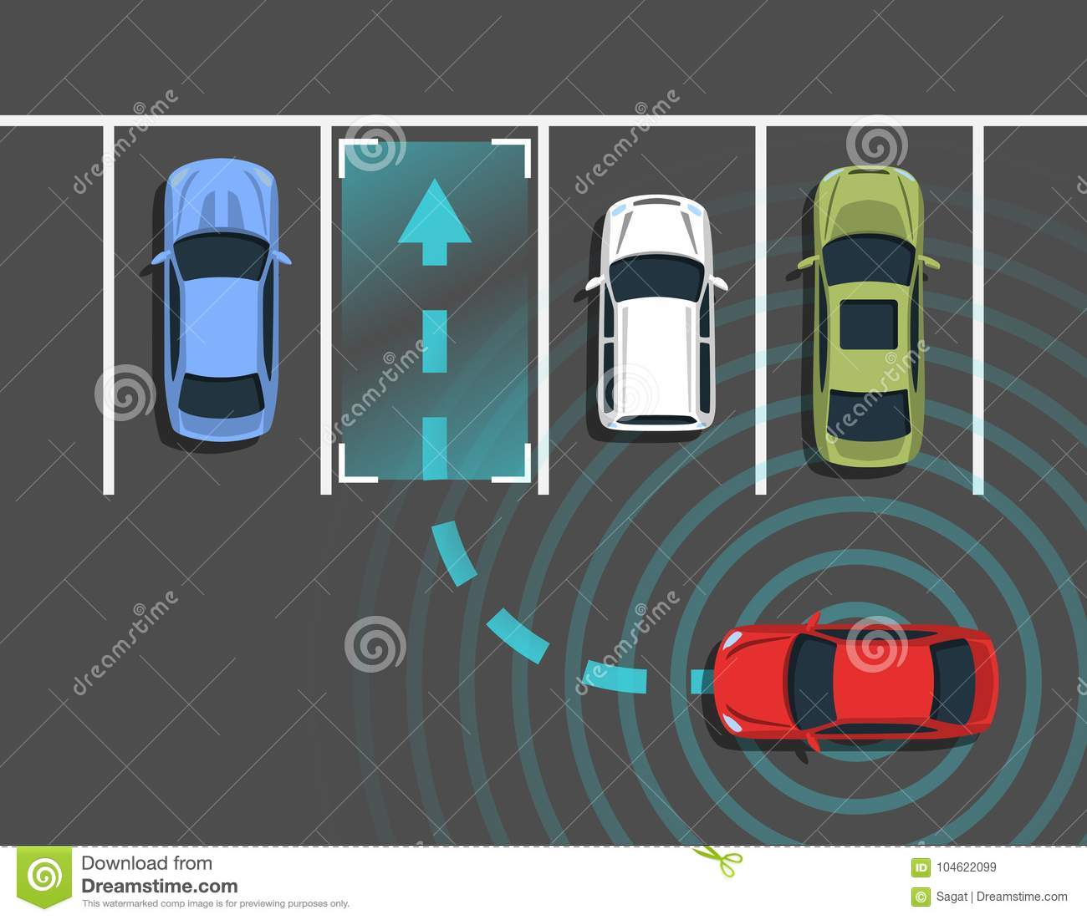
ABSTRACT
A supervised learning-based automatic parking model is proposed. A parking kinematics model will be created to calculate the various states of its movement. The model may learn and accumulate experience from several parking attempts and then demand the ideal steering wheel angle at various parking spaces.

Slide 5
Literature Review
Master general parking skill via deep learning. | Author - Lin YL, Li L, Dai XY, Zheng NN, Wang FY Year - 2017 | Used deep Neural Networks(DNN) to learn the relationship between the actual parking trajectories and the corresponding steering actions.
Assistive Parking Systems Knowledge Transfer to End-To-End Deep Learning for Autonomous Parking. | Author- Gamal O, Imran M, Roth H, Wahrburg J. Year- 2020 | This paper presents an intelligent parking system for parking Unmanned Ground Vehicle (UGV) perpendicularly using Convolution Neural Networks (CNNs).
An End-to-End Fully Automatic Bay Parking Approach for Autonomous Vehicles. | Author - Rui Li, Weitian Wang, Yi Chen, S. S., Venkat N. Year - 2018 | This paper proposed a computer vision based FAP method for the autonomous vehicles. Based on the input images from a rear camera on the vehicle, a convolutional neural network (CNN) is trained to automatically output the steering and velocity commands for the vehicle controlling.

Slide 6
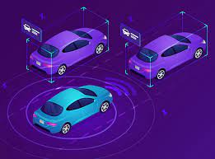
OBJECTIVES
To detect different objects by applying Computer Vision
Understanding the Concept & Working of Autonomous Vehicle
Designing & implementing the controller using steering actions
Secondary Objective
- Hardware implementation

Slide 7

Dataset
In order to accomplish the CNN based heading control we needed a lot of Data for training
We have collected the Dataset from Waymo Open Dataset.
The Dataset is extracted from Waymo self-driving vehicles and covers a wide variety of environments.
Here are the datasets in the Waymo Open Dataset for downloading. https://waymo.com/open/download/

Slide 8

Strategy
Data
Collection
Data Preprocessing
Training
Testing

Slide 9

Advantages
90% reduction in traffic deaths
Time saving vehicle
Space saving (Can hold up to 62% more vehicles)
Environmental friendly

Slide 10
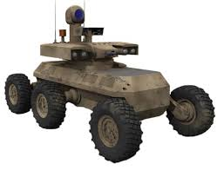
Advantages In Army
Use of man power will be reduced and shift it to machines.
During war time autonomous vehicle can be used to spy and attack on enemies so no chance of casuality.

Slide 11

Educational Outcomes
At the end of this project, we will be able to
Use AirSim/Keras/Carla
Develop knowledge about Neural Network
Use different libraries of python
Learn Computer Vision, Deep Learning and Control System
Learn to implement algorithm of Neural Network on real time data

Slide 12

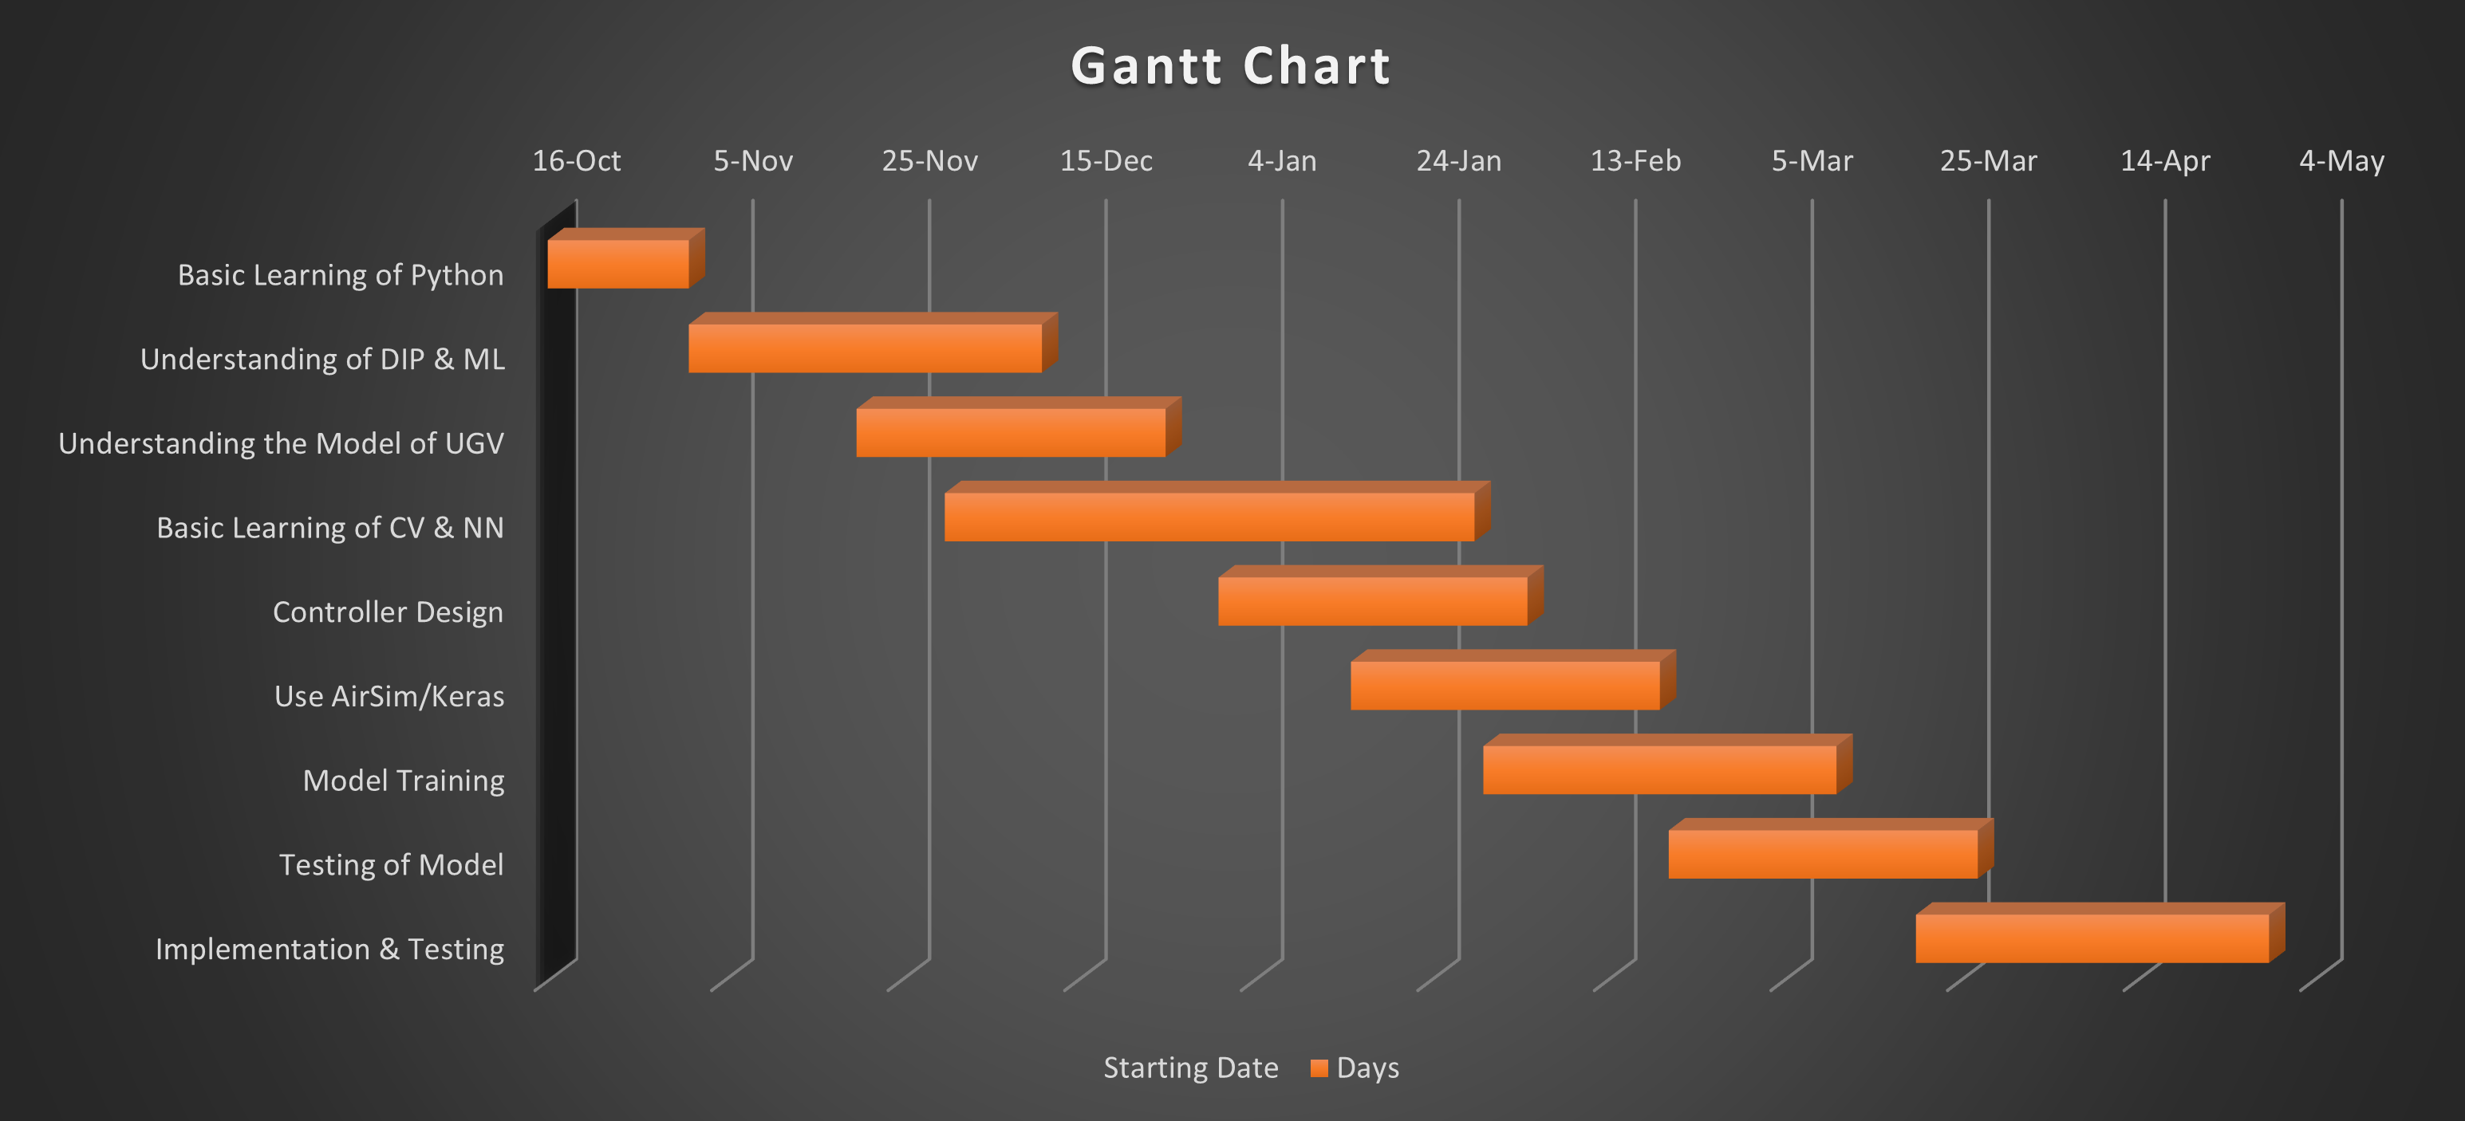
TIMELINE

Slide 13

Work Division
Mustaqeem Ashraf (Team Leader) & Mazahir Hussain
Processing of collected Data
Learn TensorFlow library
Deep Learning Algorithms (CNN)
Training of Model
Shamsa Kanwal & Tooba Anwar
Collection of Data Set
Learn OpenCV library
Controller Design & Implementation
Documentation & Styling

Slide 14

Conclusion
Implementing Computer Vision ,Deep Learning and Control System
We will be using Supervised Learning Approach that is of training a CNN with the help of images for basic adaption of Auto-Parking Vehicle
We can mainly eliminate human experience and learn parking strategies autonomously and quickly using this technology

Slide 15

Thank You

Slide 16
References
[1] Lin YL, Li L, Dai XY, Zheng NN, Wang FY. Master general parking skill via deep learning. IEEE Intell Veh Symp Proc 2017:941–6. https://doi.org/10.1109/IVS.2017.7995836.
[2] Gamal O, Imran M, Roth H, Wahrburg J. Assistive Parking Systems Knowledge Transfer to End-To-End Deep Learning for Autonomous Parking. 2020 6th Int Conf Mechatronics Robot Eng ICMRE 2020 2020:216–21. https://doi.org/10.1109/ICMRE49073.2020.9065014.

